Slide 1
Log Triage Tool Overview
Johnson Amalraj
Last updated on 30-June-2025

Slide 2
Agenda
Why Log Triage Tool?
Features
How to use
Future Ideas to consider

Slide 3
Why Log Triage Tool?
This tool is designed to assist in triaging and analyzing simulation log files efficiently.
Supports multi-user collaboration, exclusion management and session persistence.
Manual log review is time-consuming and error-prone.
A smart triage tool can dramatically reduce debugging time.

Slide 4
Features
Folder-based log loading (*.log, *.log.gz)
Automatic parsing of ERROR, FATAL, WARNING from multiple EDA tools
Tabular view with per-column filtering and multi-column sorting
Exclusion list management and per-row comments
Export to CSV, session save/load
Visualizations: Pie chart, timeline, heatmap
Designed for efficiency, clarity, and collaboration

Slide 5
User Interface Overview
Table View: Parsed log messages
Filter Row: Per-column filtering
Menus: File, Edit, Columns, Exclusion, Log, Summary, Session, Settings, Visualization, Help
Status Bar & Progress Bar

Slide 6
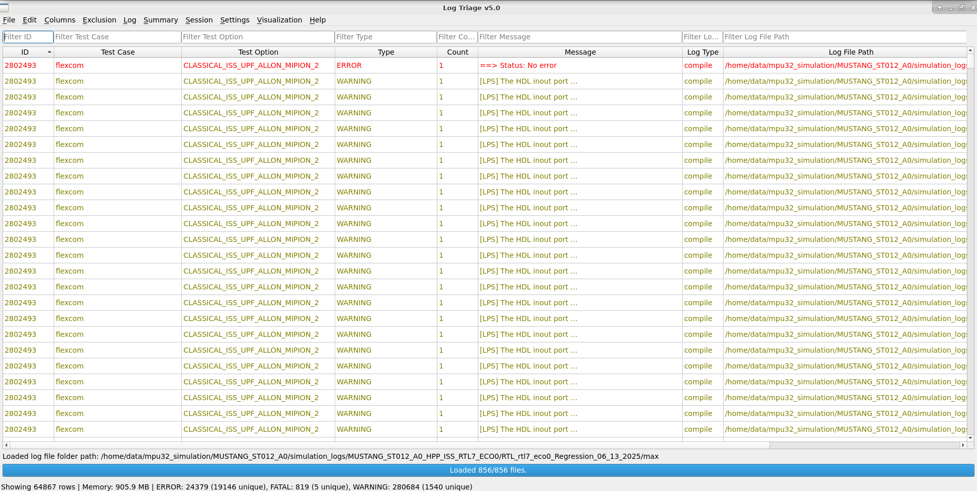
User Interface Overview (cont.)

Slide 7
Filtering & Sorting
Filter any column (text, regex, numeric)
Multi-column sorting (Shift+Click headers)
Find dialog with regex support

Slide 8
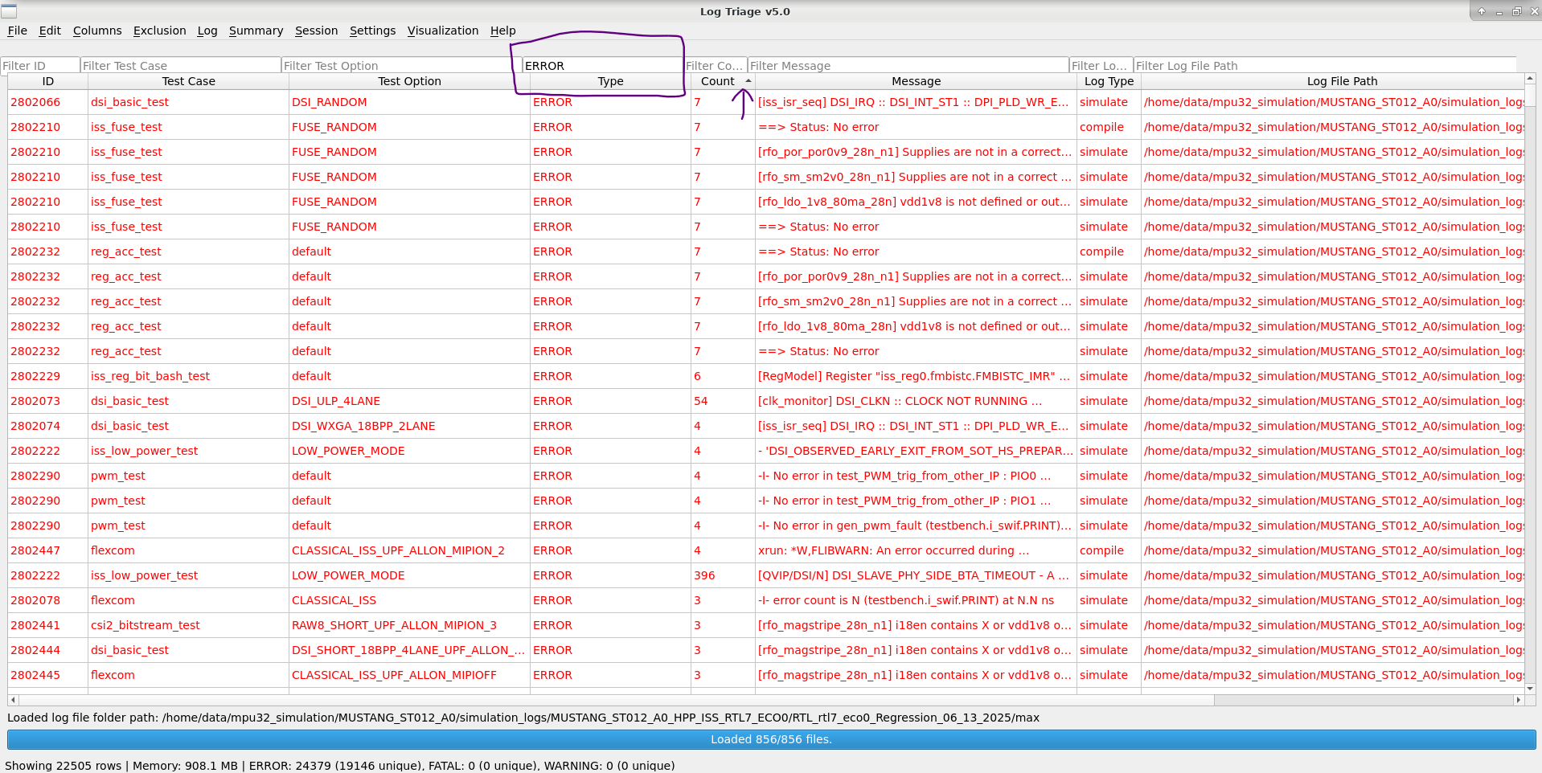
Filtering & Sorting (Cont…)
Filter applied on ‘Message’ as ‘ERROR’; ‘Count’ column sorted.

Slide 9
Exclusion & Comments
Add messages to exclusion list (Ctrl+X)
View, import, export, clear exclusions
Add/edit per-row comments by double-clicking the Comments cell

Slide 10
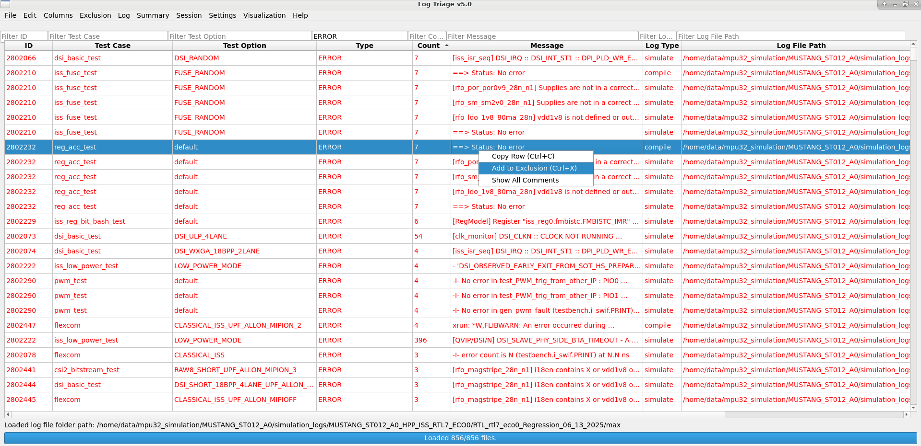
Exclusion & Comments (cont…)
Exclusion applied for the selected row

Slide 11
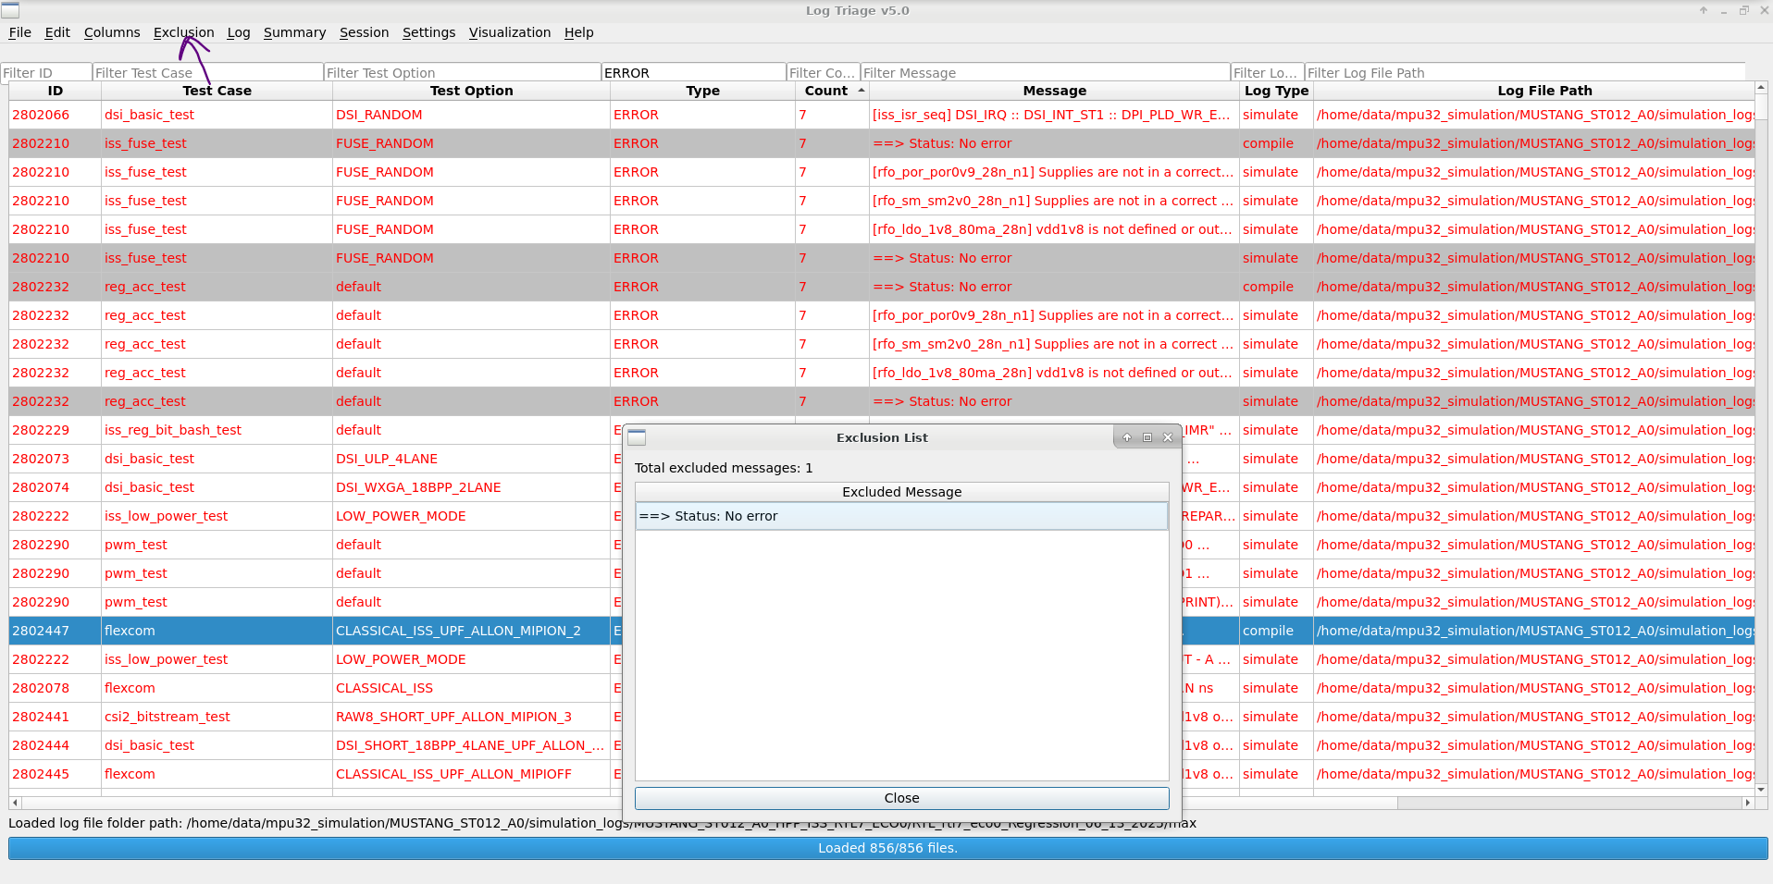
Exclusion & Comments (cont…)
After applying exclusion, the row highlighted in grey colour and you can view the excluded messages from Exclusion Menu

Slide 12
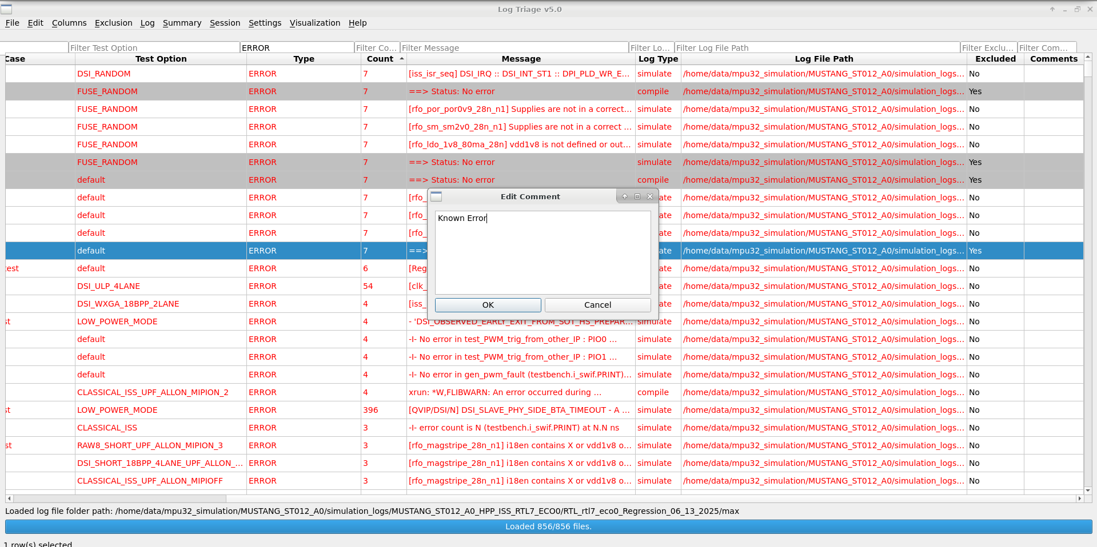
Exclusion & Comments (cont…)
You can add comments for each row, by double clicking the Comments column

Slide 13
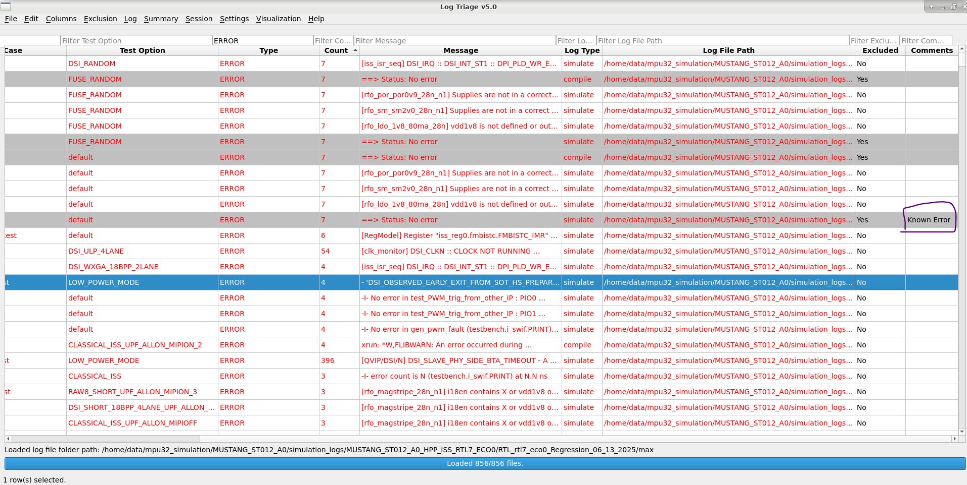
Exclusion & Comments (cont…)
Added Comments are visible in the column

Slide 14
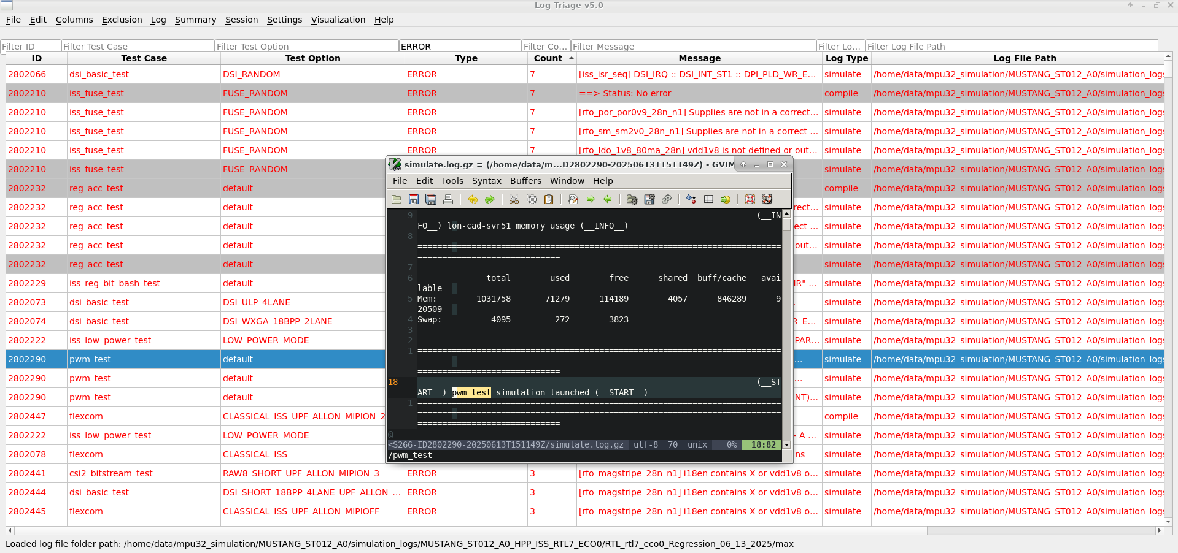
Open Log file(s)
Click a row to open the corresponding log file

Slide 15
Export & Session Management
Export filtered/selected rows to CSV
Export summary and exclusion lists
Save/load session (includes comments and exclusions)
Session persistence helps in collaborative workflows

Slide 16
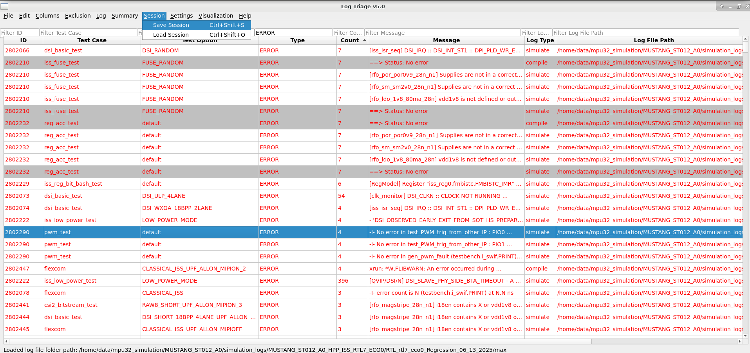
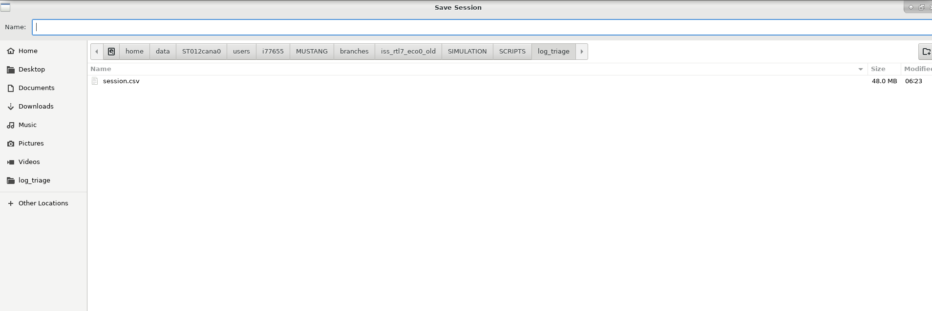
Export & Session Management (cont.)
You can save the session in *.csv format

Slide 17
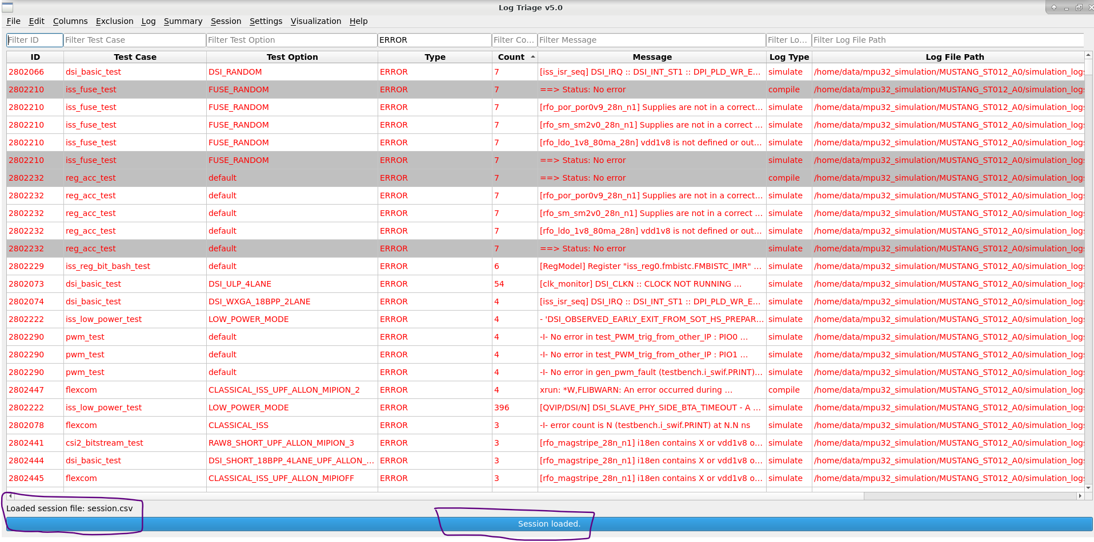
Export & Session Management (cont.)
You can load the saved session by others, to add your comments / exclusions, and check the status of the regression

Slide 18
Visualization
Pie Chart: Error type distribution
Heatmap: Error frequency by test case
Useful for identifying trends and hotspots

Slide 19
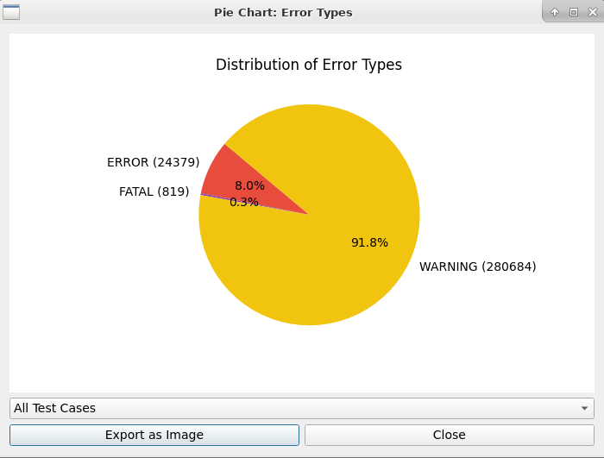
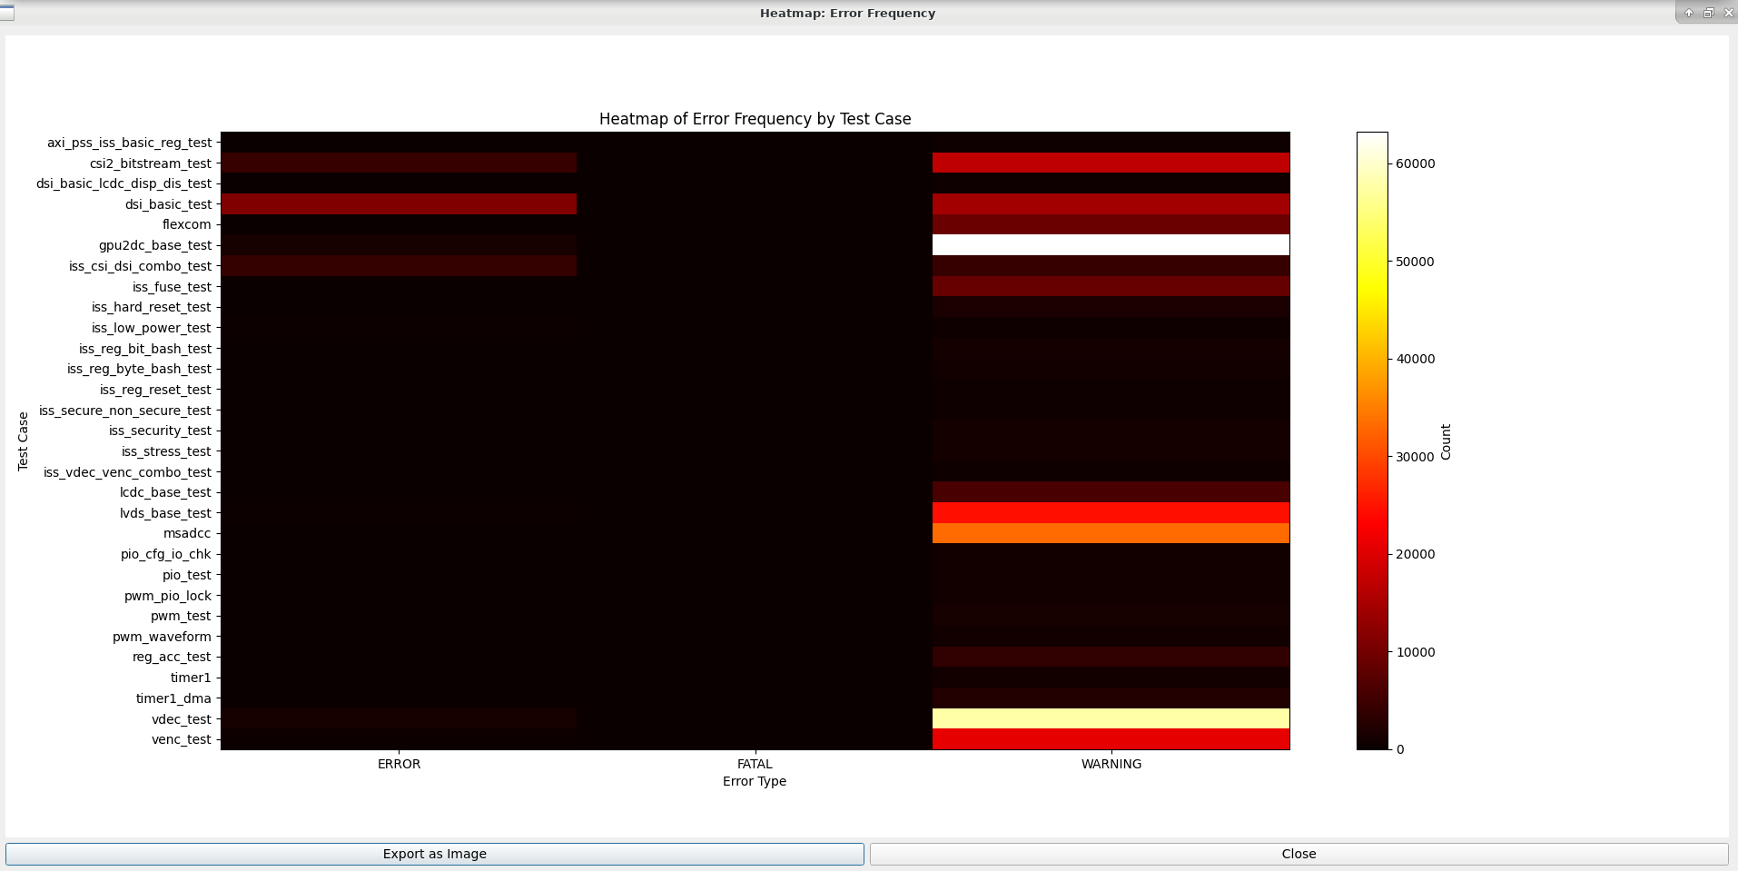
Visualization (cont.)
You can see the charts and Heatmap chart showing error and warnings counts for each test case.
You can export it as png image also

Slide 20
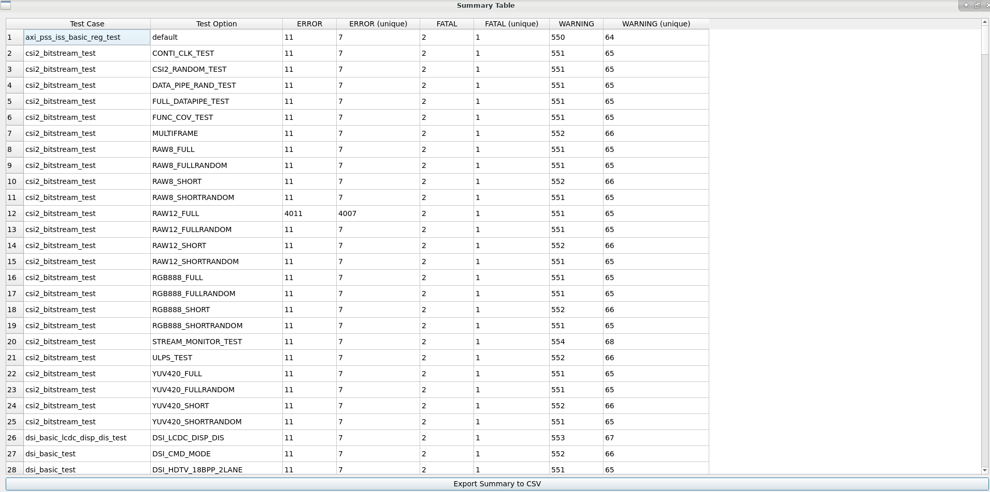
Summary
You can view the overall summary for all test cases as below

Slide 21
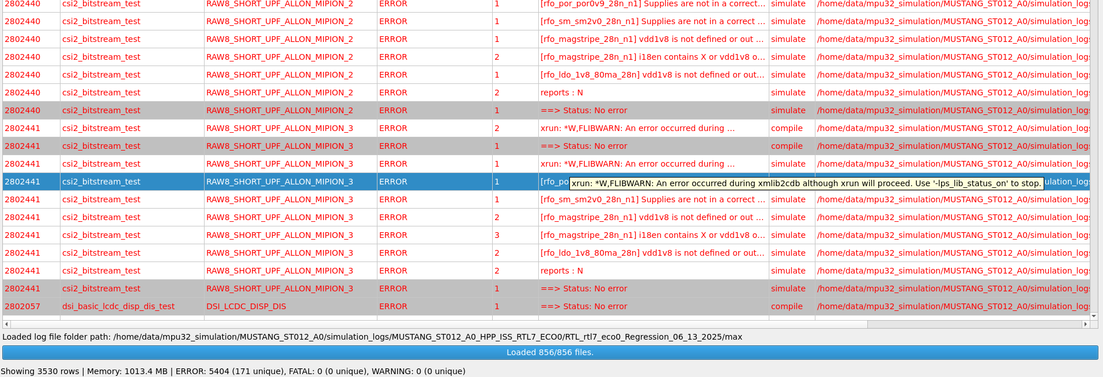
Summary (cont.)
The bottom of the tool shows an overview of the loading status and error counts along with the path of the loaded log files

Slide 22
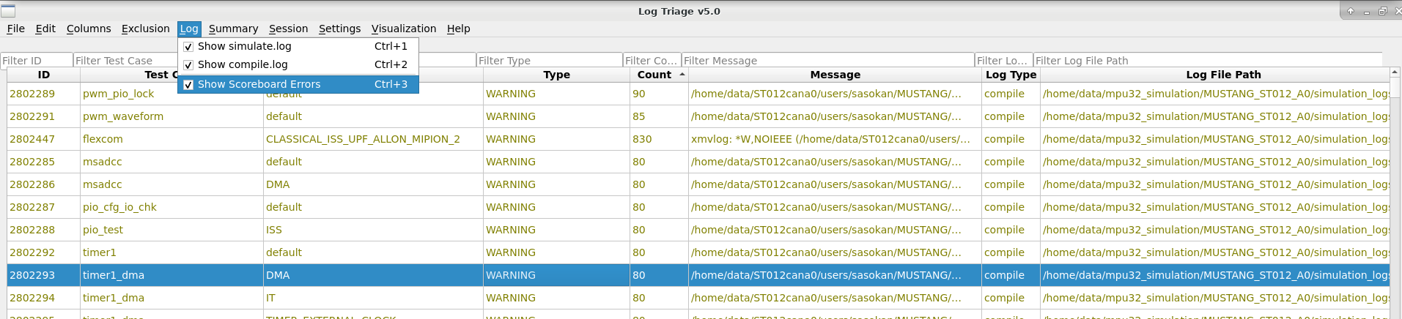
Log File Type and Scoreboard Errors
You can select which log files need to be loaded.
If you don’t want to see scoreboard errors, you can de-select that.

Slide 23
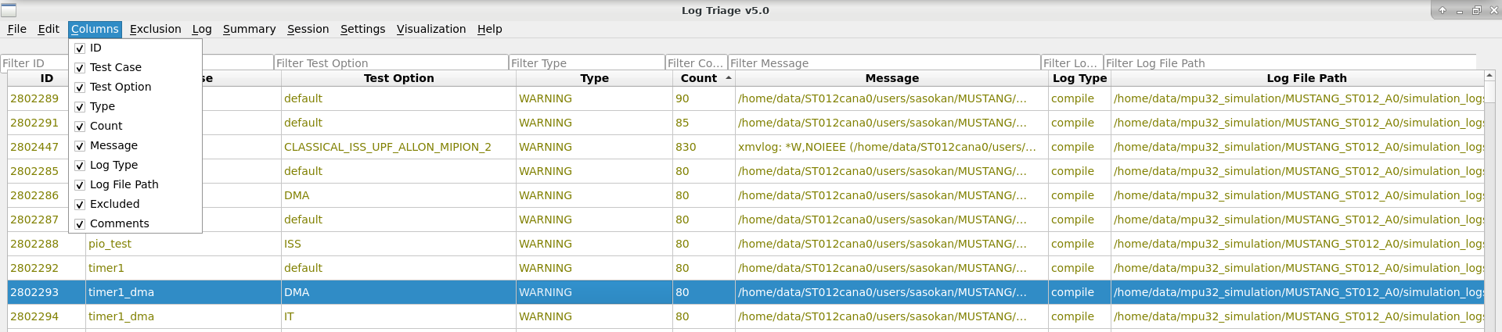
Columns selection
You can select which columns need to be displayed.

Slide 24
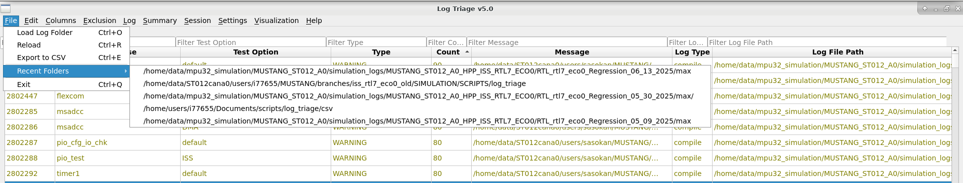
Recent Folders
Tool can save up to 5 recently opened log folders

Slide 25
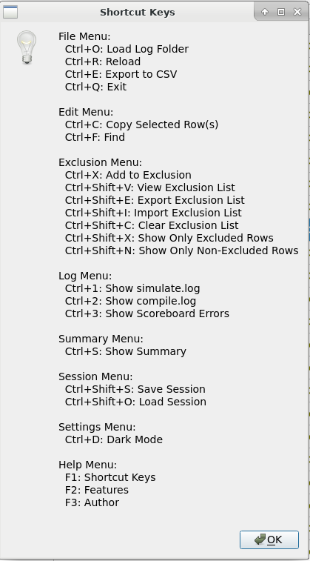
Shortcuts
All Menu options have shortcut keys

Slide 26
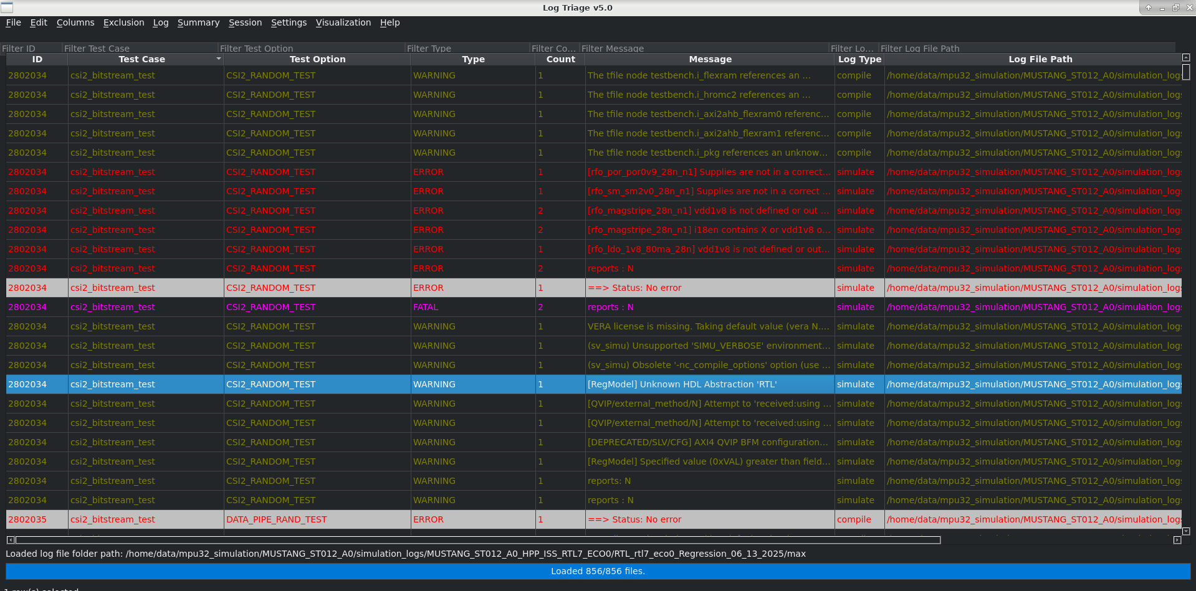
Dark Mode
Even your tool deserves a night shift. 🌙

Slide 27
Installation & Requirements
Python 3.7+
Required packages: PyQt5, matplotlib, psutil, numpy

Slide 28
Troubleshooting
Errors logged to tool_error.log
High Memory usage warning (>1GB)

Slide 29
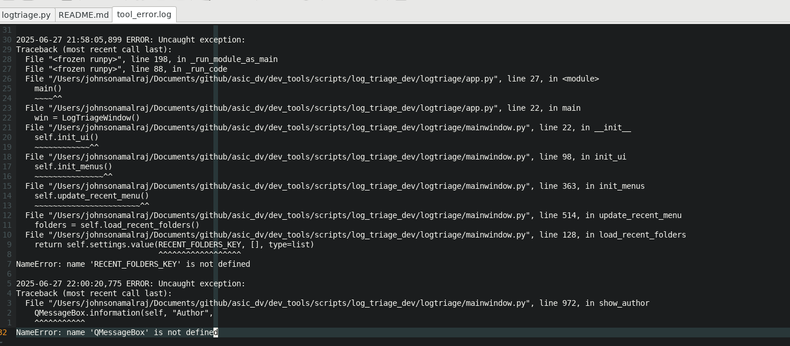
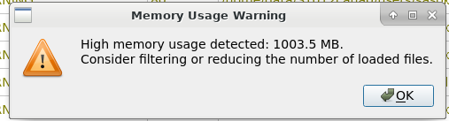
Troubleshooting (cont.)
Any tool error can be viewed from the tool_error.log file
Memory overuse (if it’s above 1000MB)

Slide 30
How to use
Load
Load log folder or saved sessions
View
Filter or sort and view only required details
Exclusions
Apply exclusions, and export/import into any sessions
Comments
Add multi-user comments and save session with comments
Export or visualize
Export summary/session/exclusion into CSV or visualize in charts/heatmap
Save/load
Save/load session

Slide 31
How to Explore
Run the log_triage.py script using python in your vnc machine as below.
On LSF:
bsub -R "rUsage[RAM=10000]" python3 log_triage.py
On Local :
python3 log_triage.py

Slide 32
Future Ideas to Consider
Tagging System: Allow users to tag log entries for categorization.
Auto-Triage Suggestions: Use simple heuristics or ML to suggest likely causes or group similar issues.
Integration Hooks: Allow integration with bug tracking tools (e.g., JIRA) or CI/CD pipelines.
Command Line Interface (CLI): For users who prefer scripting or automation.
Comments: When adding comments, apply them to all rows with the same message.

Slide 33
Feedback and Suggestions
• Please explore the Log Triage tool and share your feedback.
• Suggestions for any improvements are welcome.
• Reach out for any queries or collaboration ideas.

Slide 34
Any Questions?

Slide 35
Thank You
Johnson Amalraj

